Slide 1
by Alessio Favuzza & Marco Orlando
Bagheria: My hometown
Yesterday and today
Notes:
1

Slide 2
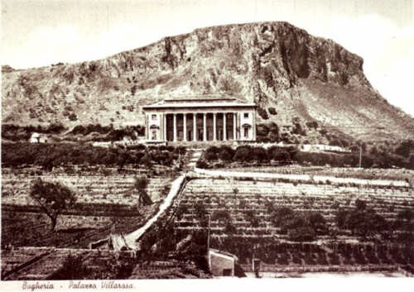
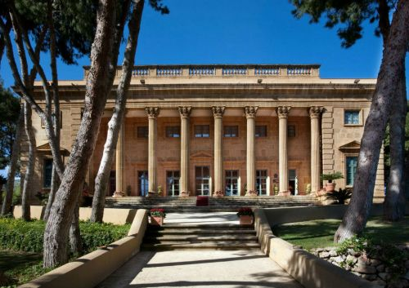
VILLA ROSA before & after
Notes:
2

Slide 3
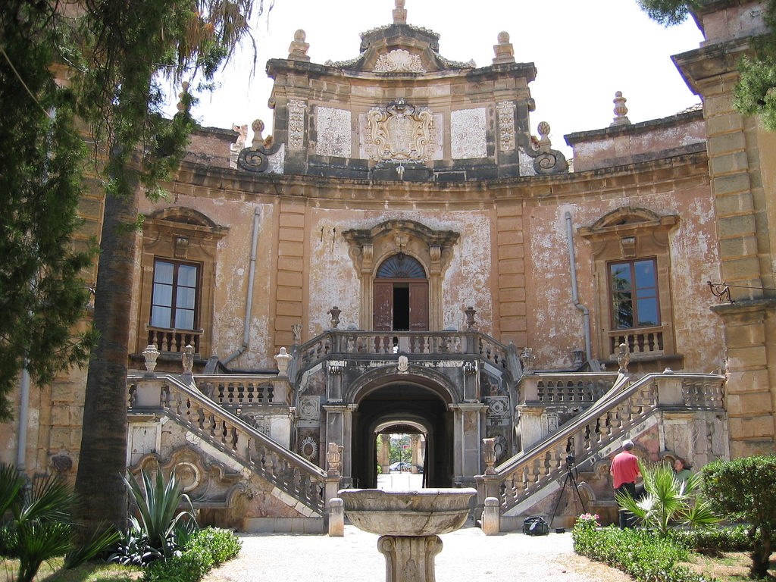
VILLA PALAGONIA before & after
Notes:
3

Slide 4
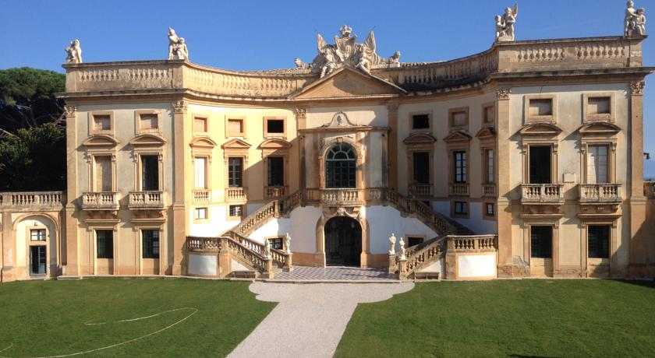
VILLA VALGUARNERA before & after
Notes:
4

Slide 5
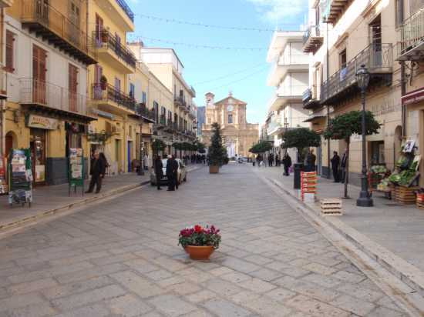
UMBERTO 1° AVENUE before & after
Notes:
5

Slide 6
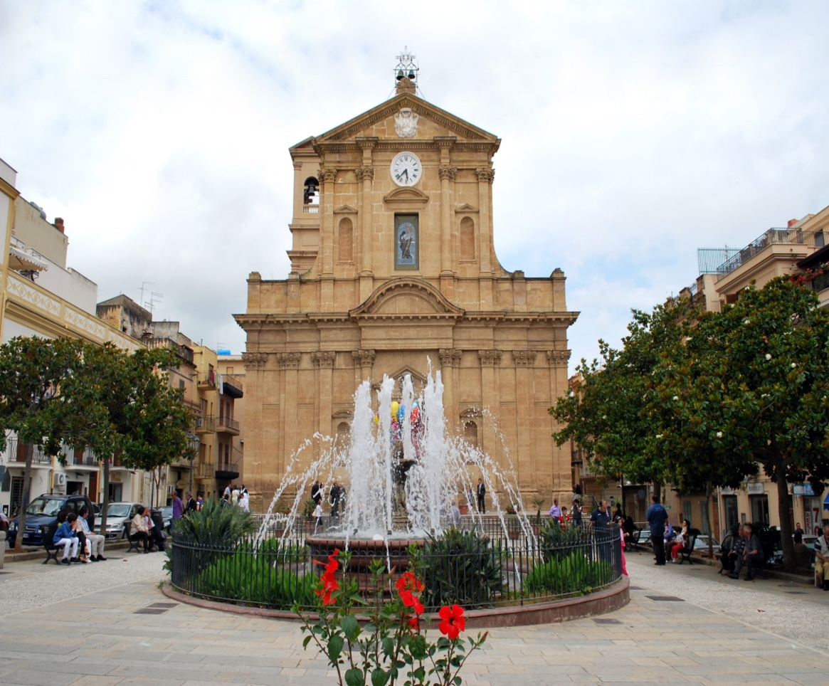
THE MAIN CHURCH before & after
Notes:
6

Slide 7
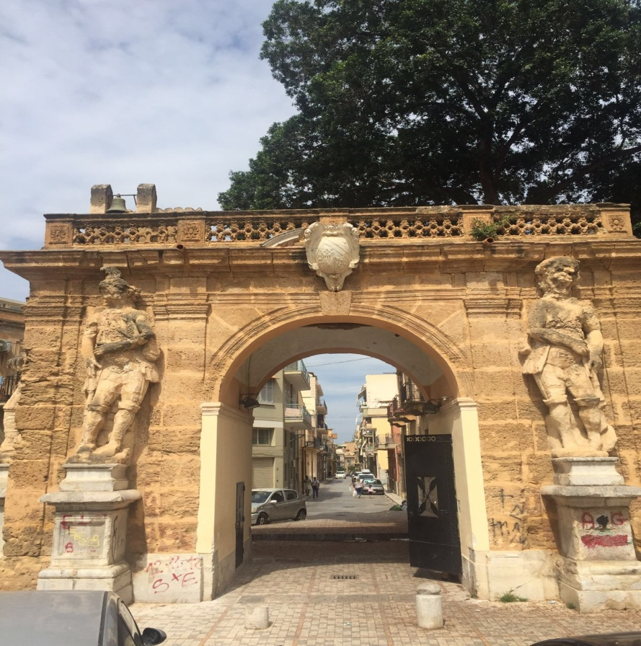
ANCIENT PALAGONIA ARCH called «The Allmighty Father Arch» before & after
Notes:
7

Slide 8
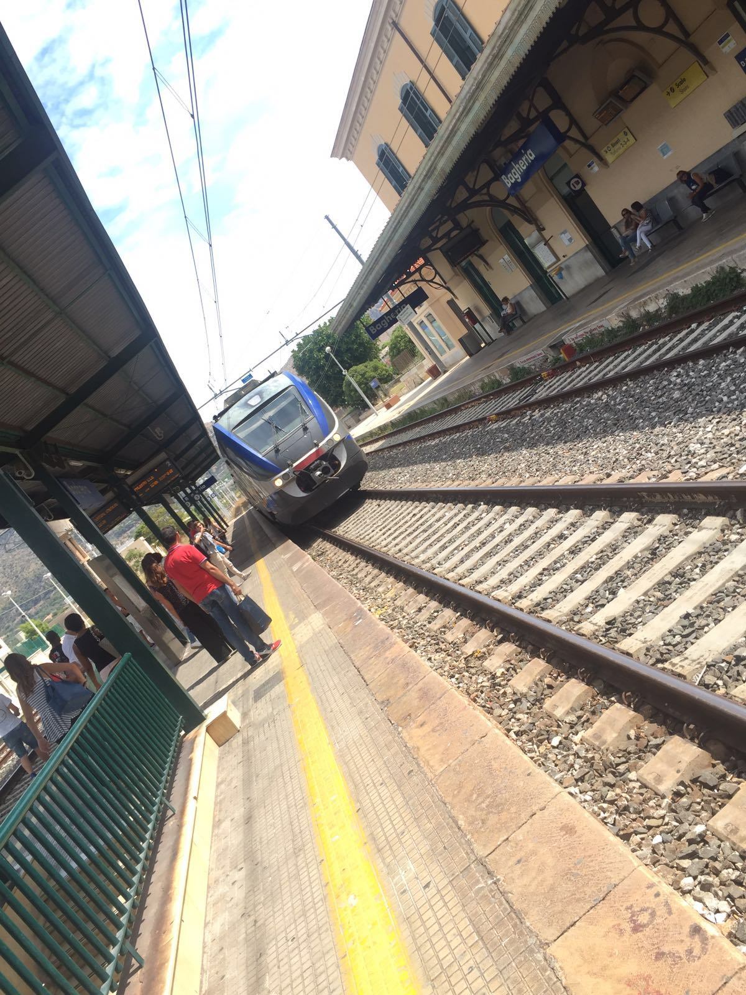
THE RAILWAY STATION before & after
Notes:
8

Slide 9
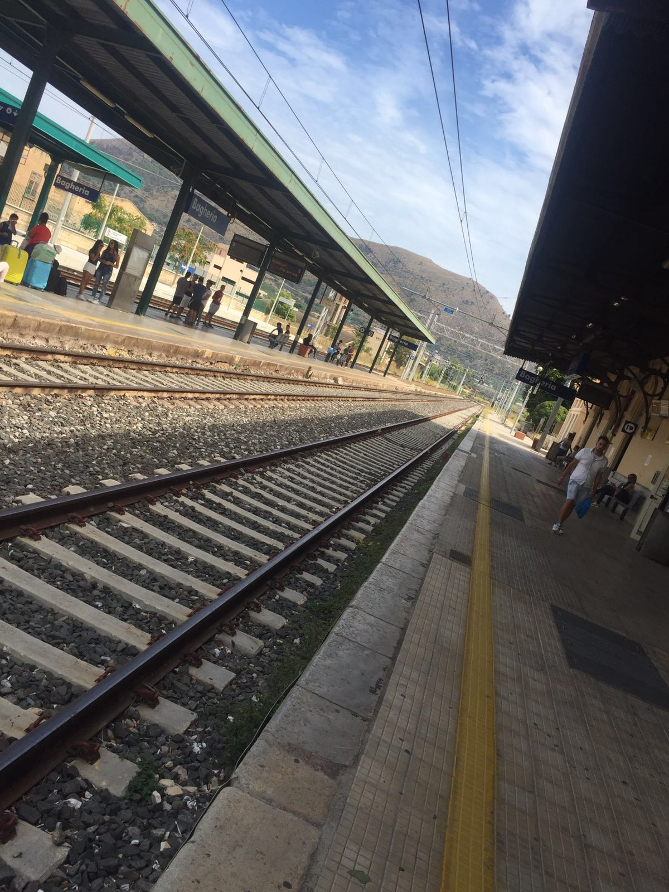
THE RAILWAY before & after
Notes:
9

Slide 10
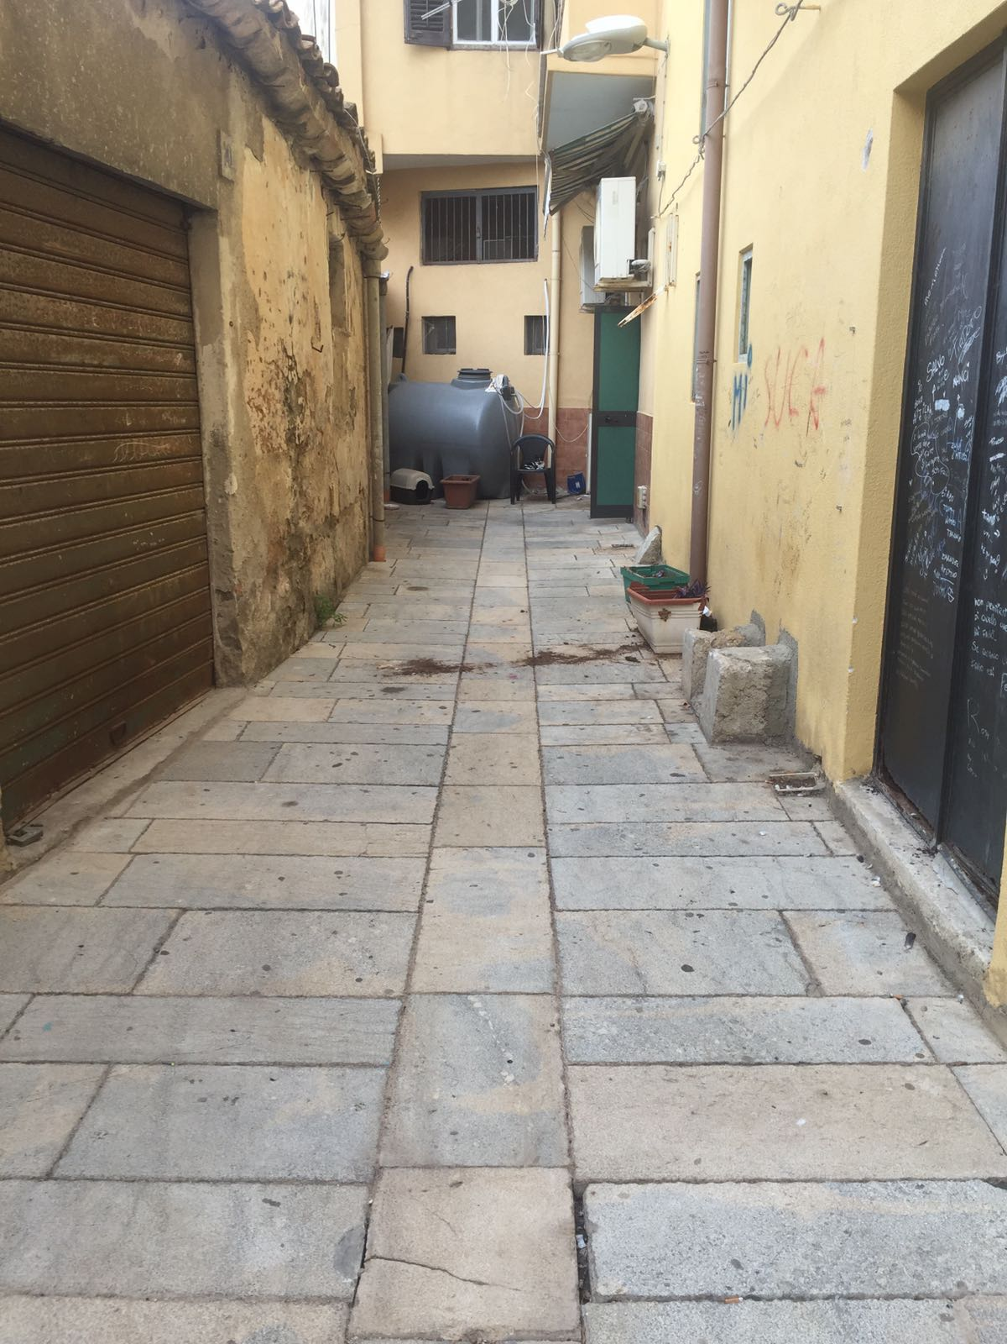
A LANE OF BAGHERIA before & after
Notes:
10

